Slide 1
Planning Applications
Site Address
Land off Trowbridge Road, Bradford on Avon
Site Address
Holt Farm, Ground Corner, Holt, Trowbridge, BA14 6RT
Additions after Agenda published
Site Address
Whistle Mead Solar Farm, Little Chalfield, Melksham, SN12 8NP
Site Address
Former Countrywide Site, Bradford Road, Melksham
Site Address
Merkins Farm, Bradford Leigh, Bradford On Avon, BA15 2RW
Site Address
Land off Melksham Road, Holt

Slide 2
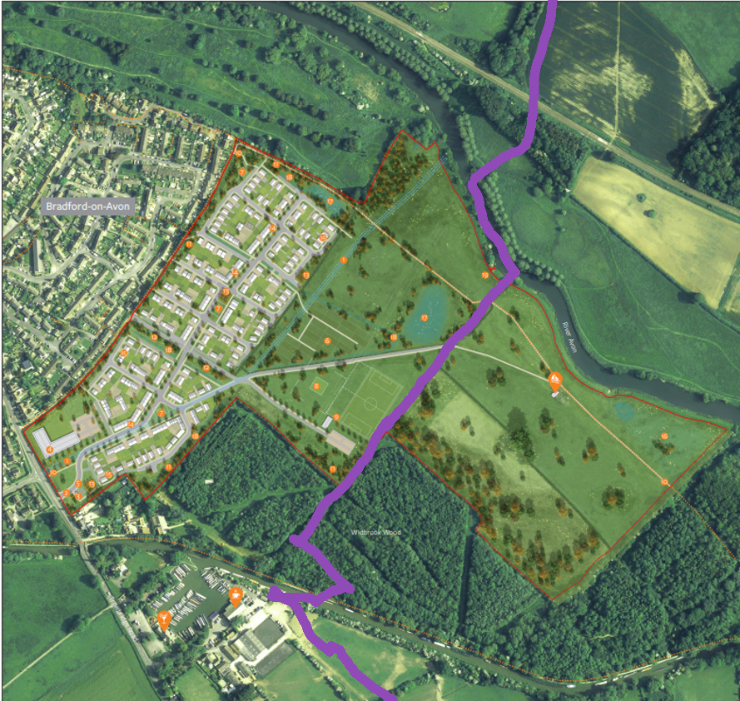
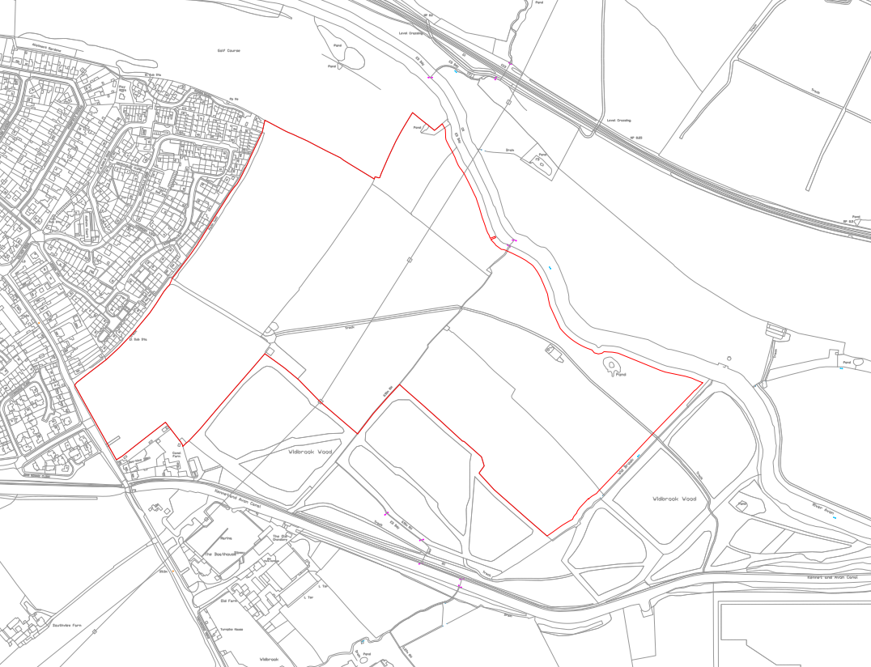
Site Address
Land off Trowbridge Road, Bradford on Avon
https://development.wiltshire.gov.uk/pr/s/planning-application/a0iQ300000LPXeGIAX/pl202602943
Proposal
Outline application (with all matters reserved except for access) for the erection of up to 224 residential dwellings (Class C3), 72-bed care home (Class C2), with sports pitch provision, country park, allotments, landscaping and open space.
Officer Name
Steven Simms
Consultation Deadline
26/06/2025. Ext – 17/07/26
I have tried to put in the purple line as our parish boundary so anything to the right is Holt.

Slide 3
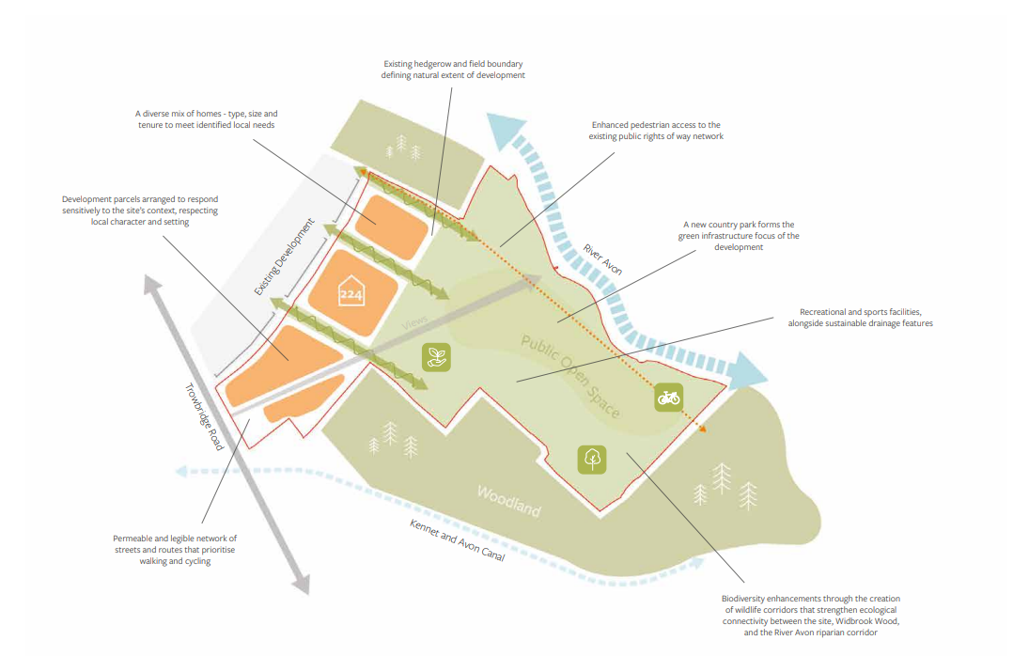

Slide 4
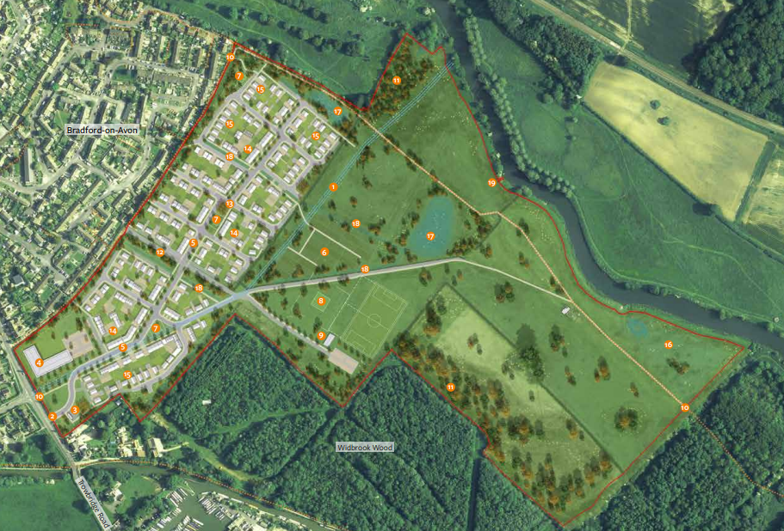
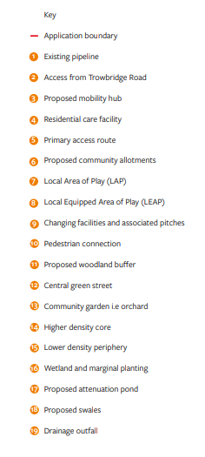

Slide 5
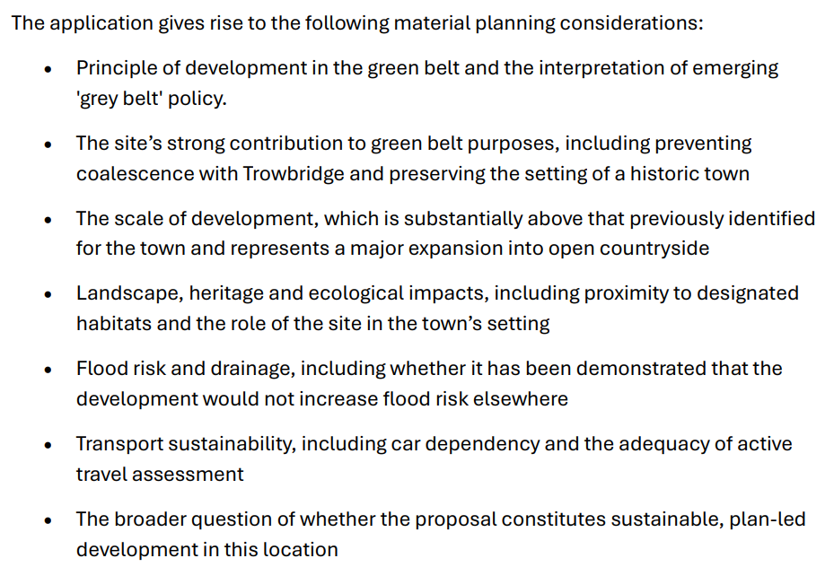
BOA Town Council called it in.

Slide 6
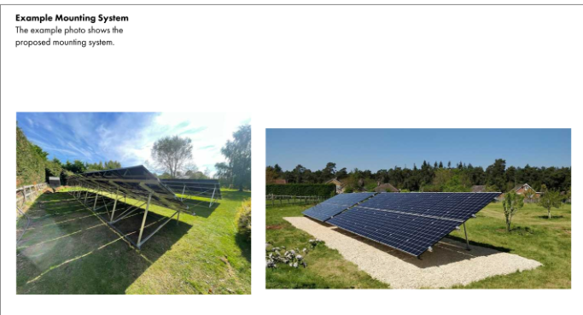
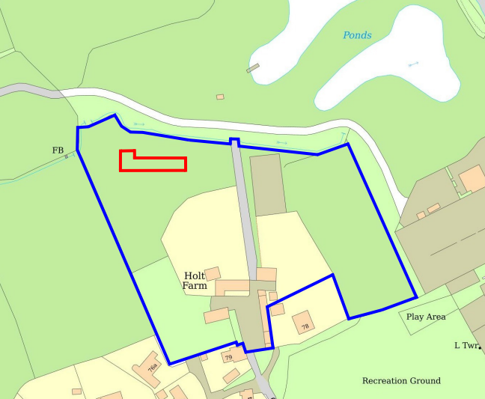
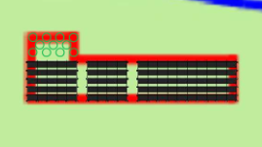
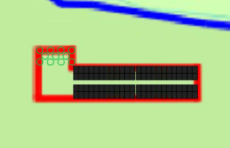
Site Address
Holt Farm, Ground Corner, Holt, Trowbridge, BA14 6RT
https://development.wiltshire.gov.uk/pr/s/planning-application/a0iQ300000M0BA5IAN/pl202603491
Proposal
Variation of Condition 2 (Approved plans and documents) of PL/2026/00705 to allow for changes to the mounting system and an increase in 1 panel
Officer Name
Andrew Thomas
Consultation Deadline
10/07/2025
Proposal
Proposed installation of 95 panels mounted via a low profile ground mounted racking system.
approved
96 panels – new proposal

Slide 7
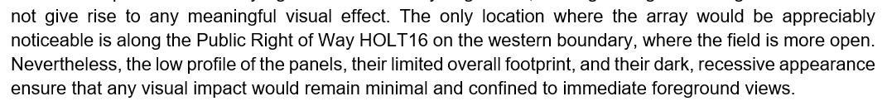
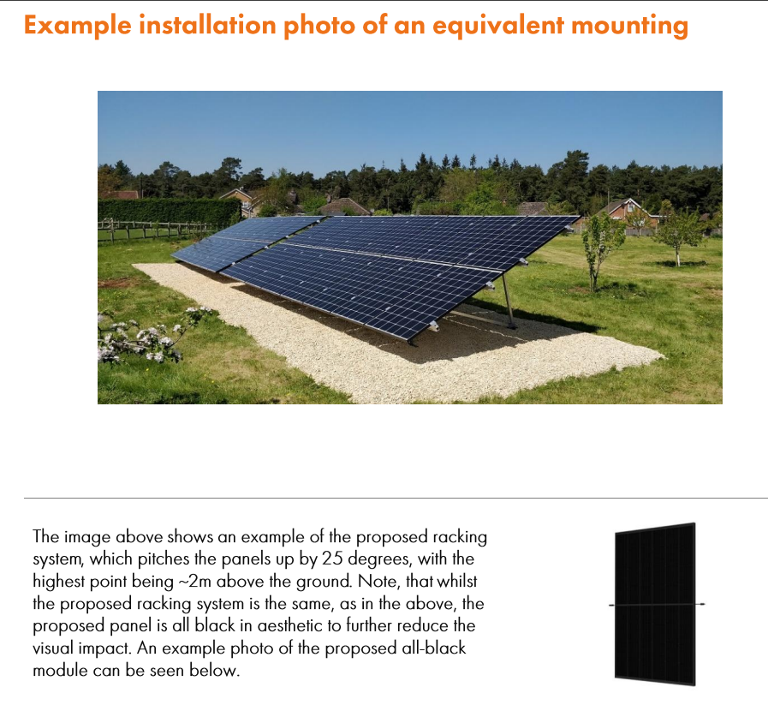
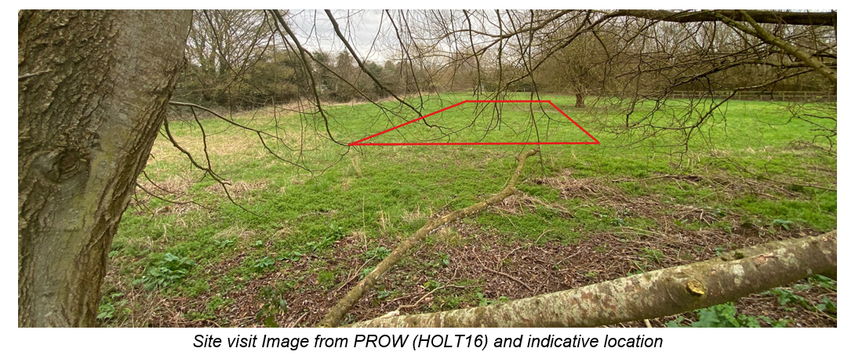
Officer Report – approval of low profile ground mounted system…
Planning Statement
for new proposal.

Slide 8
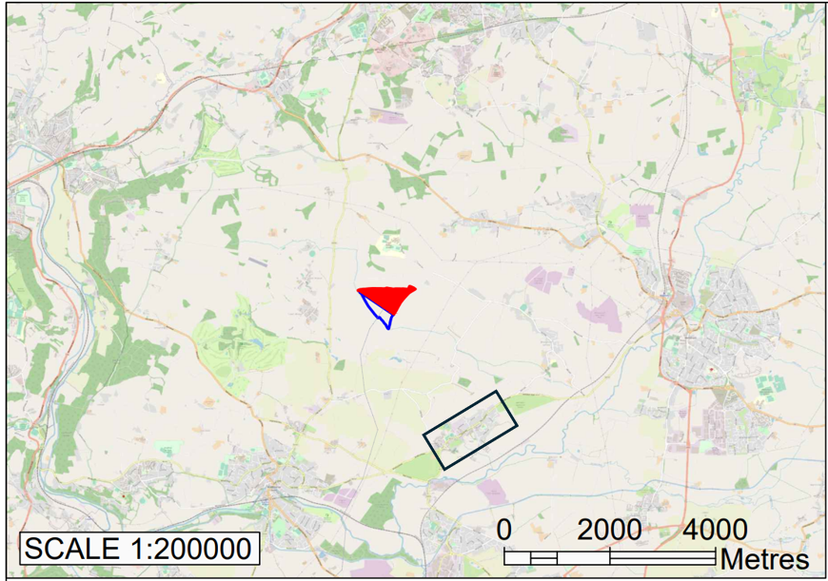
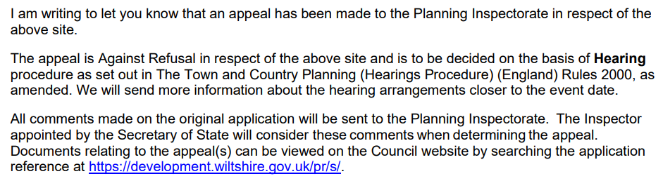
Site Address
Whistle Mead Solar Farm, Little Chalfield, Melksham, SN12 8NP
https://development.wiltshire.gov.uk/pr/s/planning-application/a0i3z000019rh87AAA/pl202301914?tabset-8903c=3
Proposal
Proposed temporary planning permission for 40 years for the development of a solar farm of up to 24.14MW of generating capacity, comprising of the installation of solar photovoltaic panels and associated infrastructure including customer cabin, customer substation, DNO substation and equipment, inverter and transformer substations, spare part container, associated battery storage, access tracks, widening of existing highway access, fencing, security cameras, landscape planting, ecological improvements and associated works. The existing agricultural use of the site will also continue in tandem with the solar farm with the grazing of farm animals.
Officer Name
Verity Giles-Franklin
Consultation Deadline
21/07/2026

Slide 9
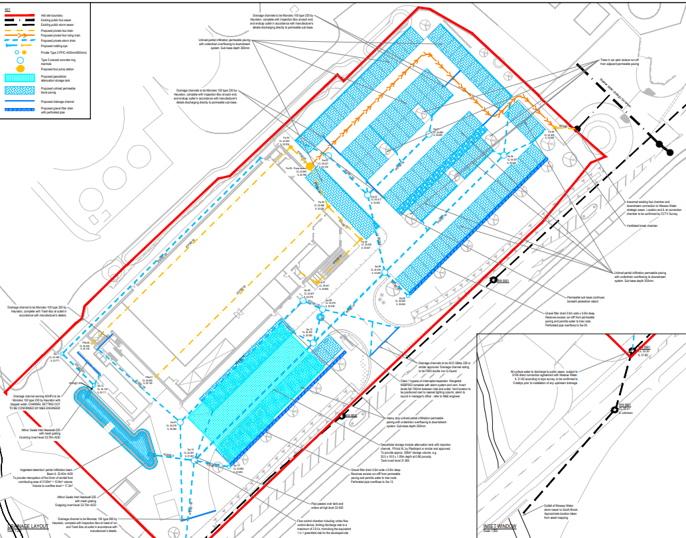


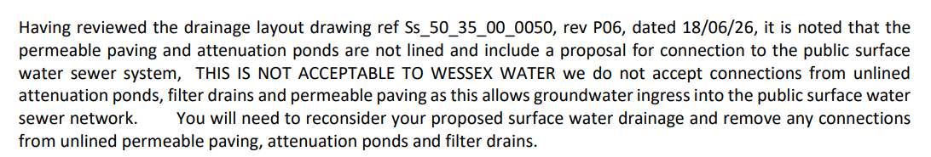
Site Address
Former Countrywide Site, Bradford Road, Melksham
https://development.wiltshire.gov.uk/pr/s/planning-application/a0iQ300000GKZlBIAX/pl202507044
Proposal
The construction of a new discount foodstore, car parking, access and landscaping on land at Bradford Road, Melksham
Officer Name
Jonathan James
Consultation Deadline
23/03/2026

Slide 10
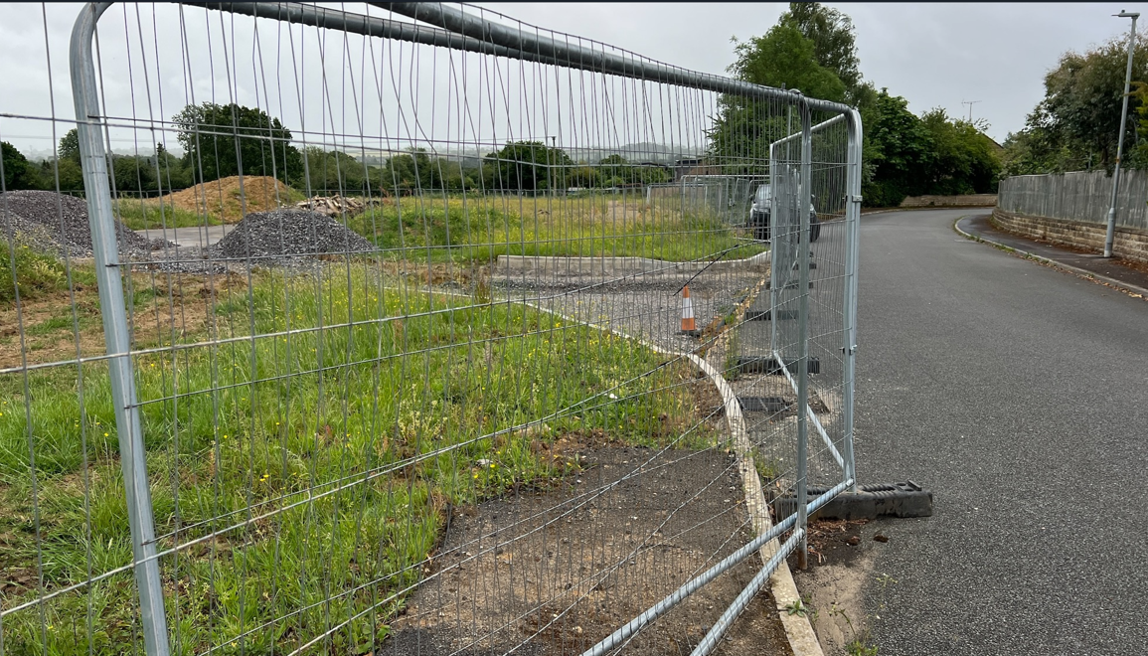
Proposal
Application for a Lawful Development Certificate to confirm that outline planning permission PL/2022/03315, with reserved matters approval PL/2025/04414, has been lawfully commenced.
Bewley
Approved Reserved Matters
Know they are selling the site.
Awaiting any news.
Planning Officer explained s73 likely.
Public consultation like Reserved Matters
Are changes acceptable or better?
Clearly identify areas not acceptable with reason.

Slide 11
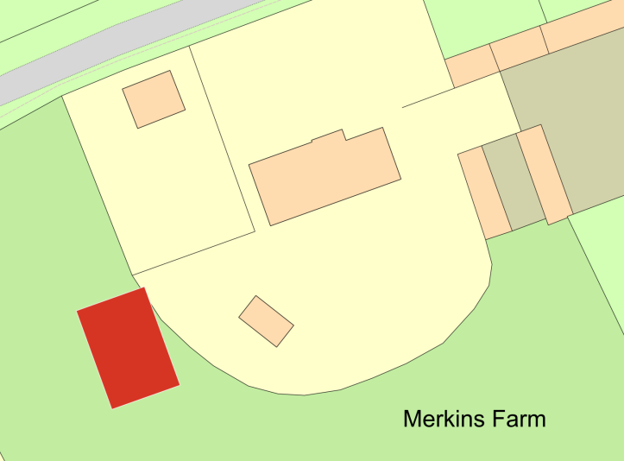
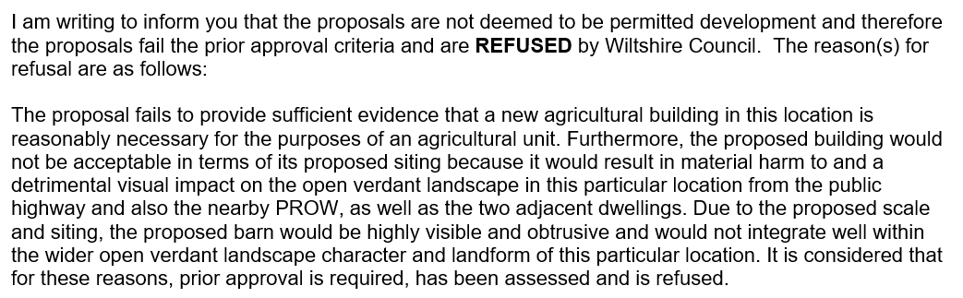
Site Address
Merkins Farm, Bradford Leigh, Bradford On Avon, BA15 2RW
https://development.wiltshire.gov.uk/pr/s/planning-application/a0iQ300000LbVf3IAF/pl202603122?tabset-8903c=2
Proposal
Steel framed agricultural building
Officer Name
Angela Ellis

Slide 12
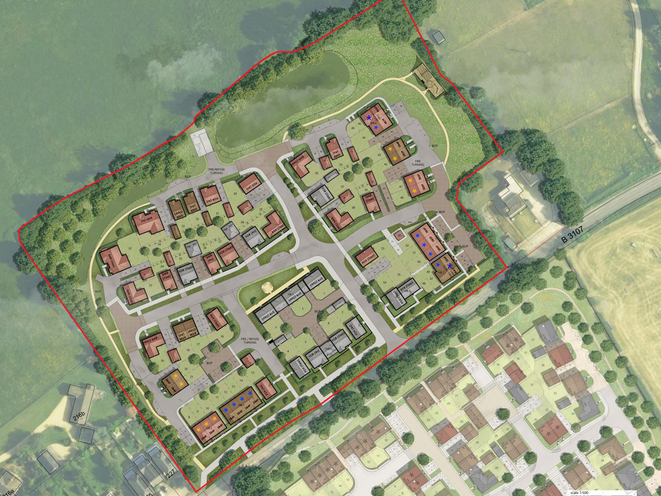
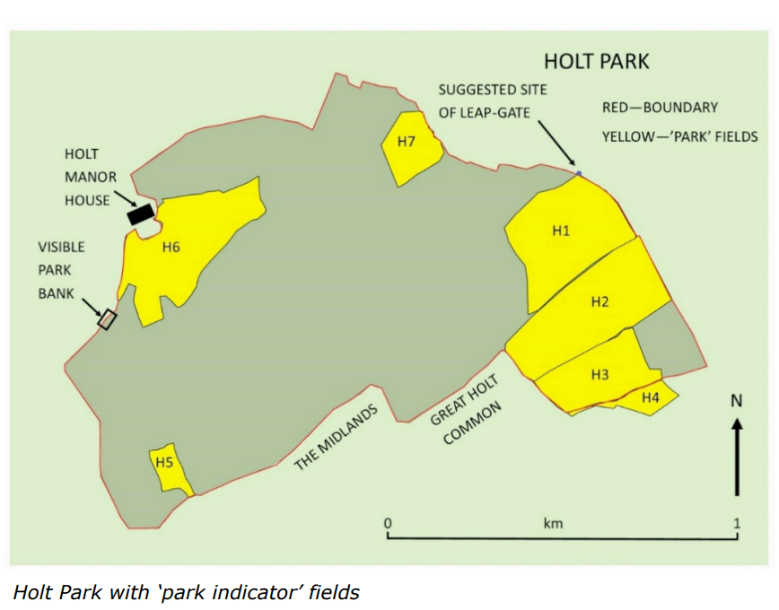
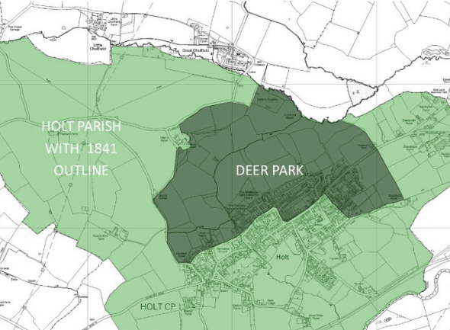
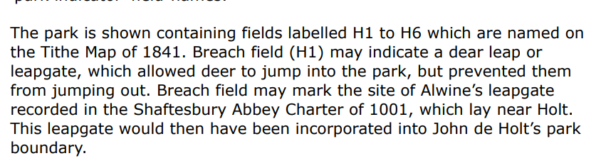

Slide 13
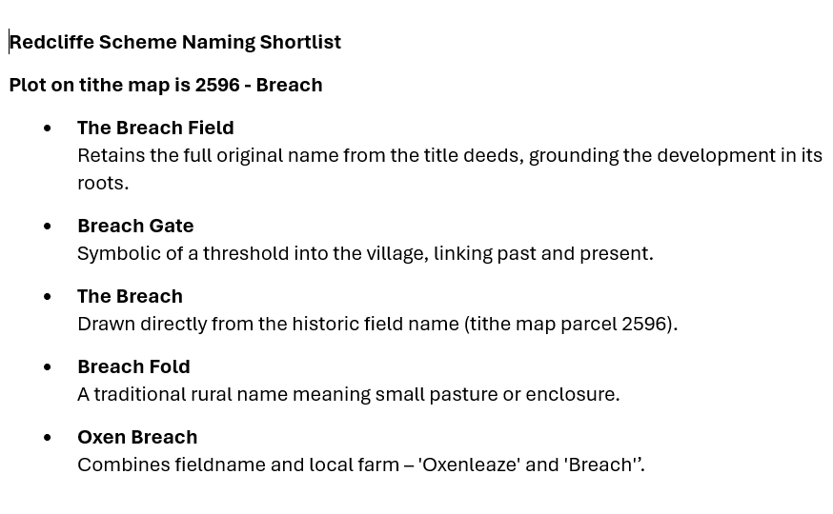
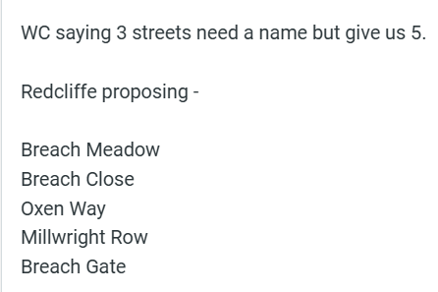
Bewley Street Names
Twelve Acre Road
Packhorse Way
Palfrey Walk
Park Mead
Lower Well Close
Fallow Green
Farrier Green
Chase Row
St. Katharine’s Row
HPC propose
Breach Close
Oxenleaze Way
Leapgate Place
Deer Park Drive
Stag Row

