Slide 1
LHFIG requests- 5 areas and 5 dropped kerb locations.
1. The Midlands to Glove Factory entrance.
Levelling of footway to offset the camber, reuse existing kerb stones, redo double yellow lines.
2. Station Road from The Star to Star Ground.
Insert dropped kerbs to access the footpath and footway. Improve footway surface to first dwelling on Station Road.
3. Bradley Lane.
Create footway that is level, wide enough and has a safe surface with kerb edging as per footway created at other end of Bradley Lane. There is no footway here for pedestrians.
4. Ham Green to Ground Corner, outside Old Ham Tree
Create footway that is level, wide enough and has a safe surface with reuse of existing kerbs for edging to keep rural conservation area of village. Dropped kerb and on opposite side too for accessibility.
5. Leigh Road to Ham Green
Improve definition of dropped kerb outside 56 Ham Green and investigate safe crossing place to bus stop either here or at end of footpath by lamppost.

Slide 2
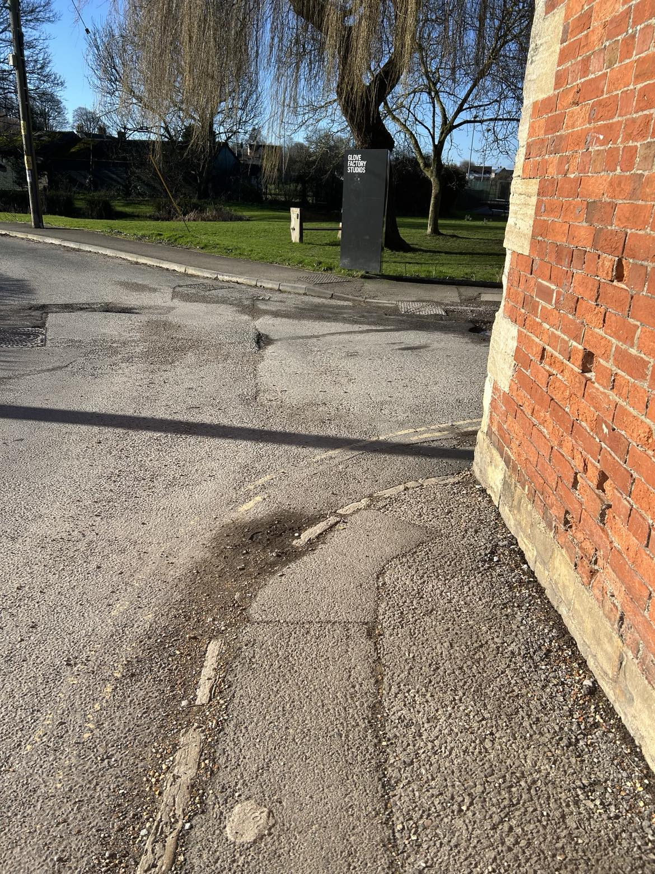
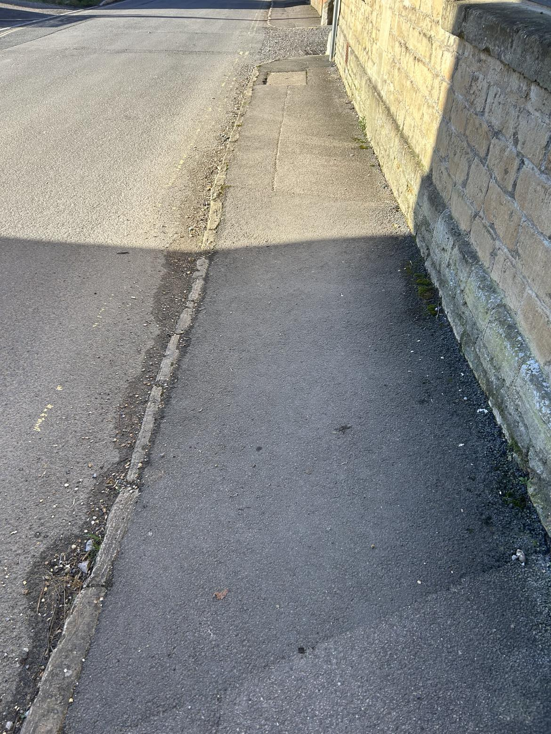
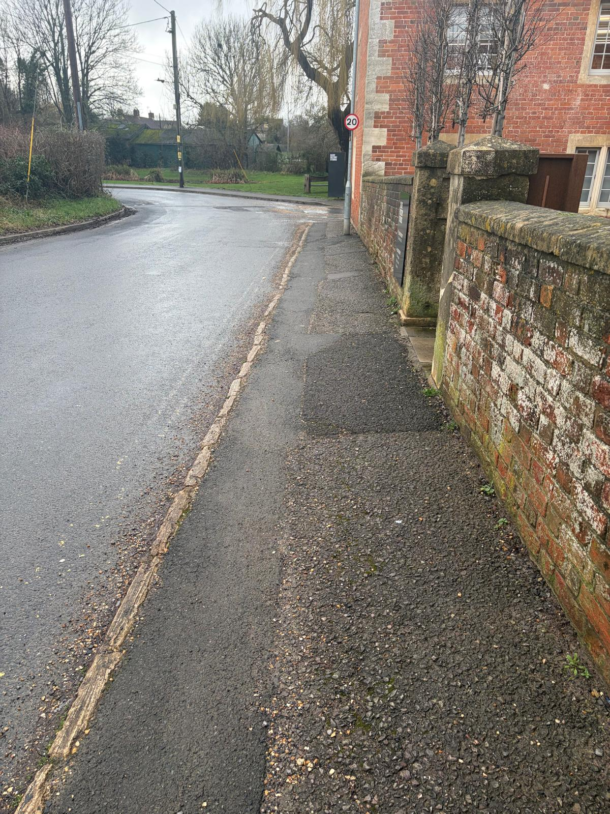
1. The Midlands
11. General rough state of footway, no clear defined edge to road or the access to GFS. Busy entrance and exit and no clear stop point. Double yellows need redoing or even white lines for visibility?
10. Camber on footway – if in wheelchair would tip you out.
2026 additional photo
00239732 This issue relating to footpath condition does not meet the intervention levels for repair. Faded yellow lines have been reported and any improvements like the raising of kerbs should be raised through the LHFIG scheme. ​
00239730 This issue does not meet the intervention levels for repair set out in Wiltshire Council's Safety Inspection Manual. No other complaints received, low priority. ​

Slide 3
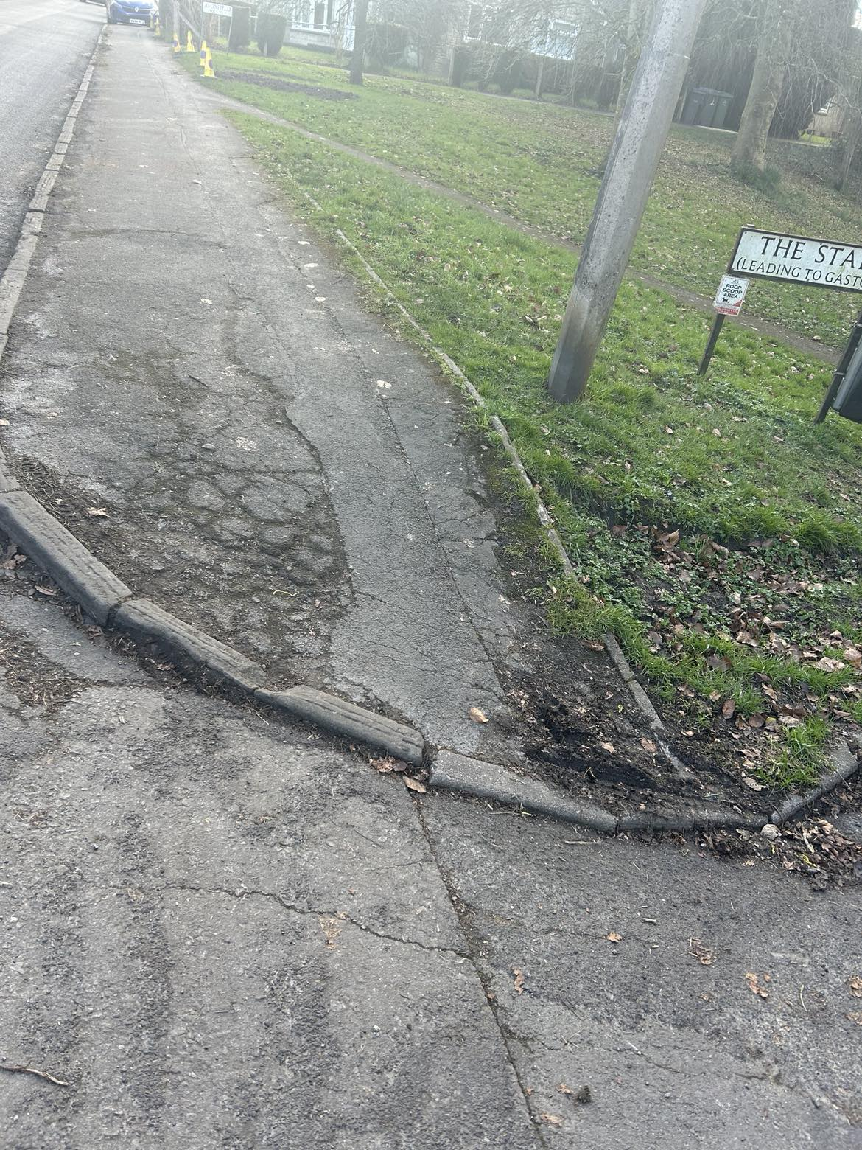
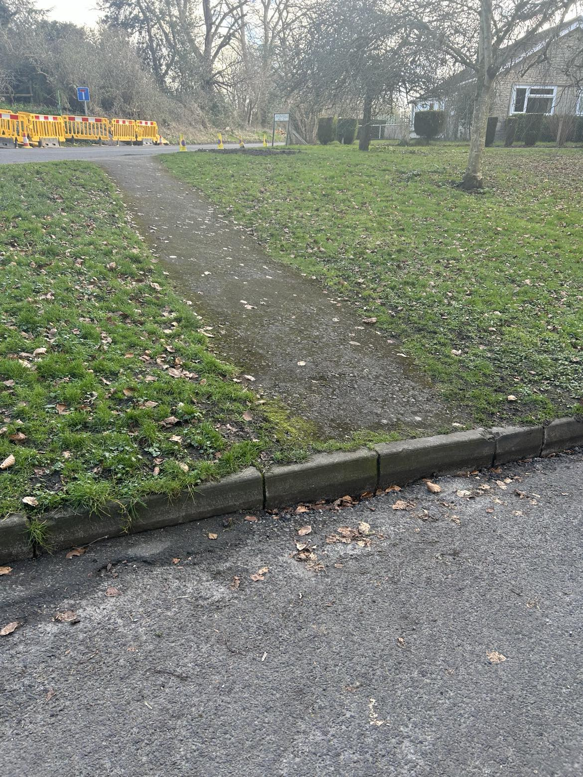
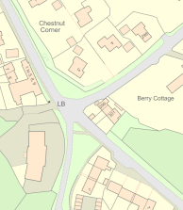
2. Station Road from The Star to Star Ground.
48
47
48. Very poor condition dropped
Kerb access to Station Road
footway. Uneven and bumpy
footway as well considering residents who use this area.
48a. Footpath from The Star/Avonfield ends with high
kerb. Dropped kerb required.
LFHIG ​

Slide 4
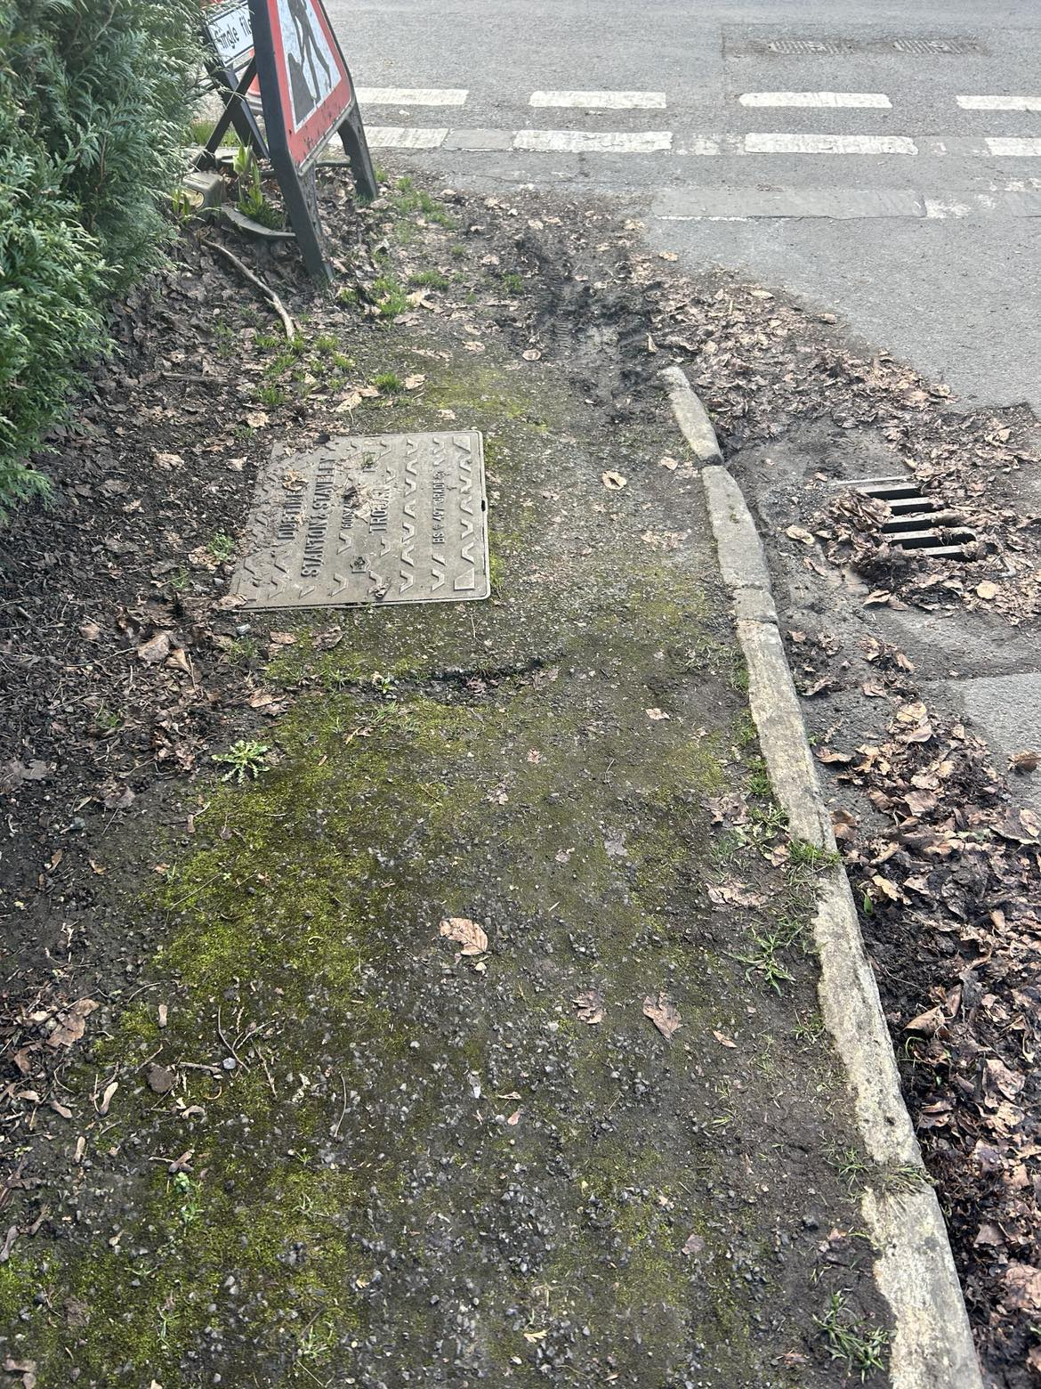
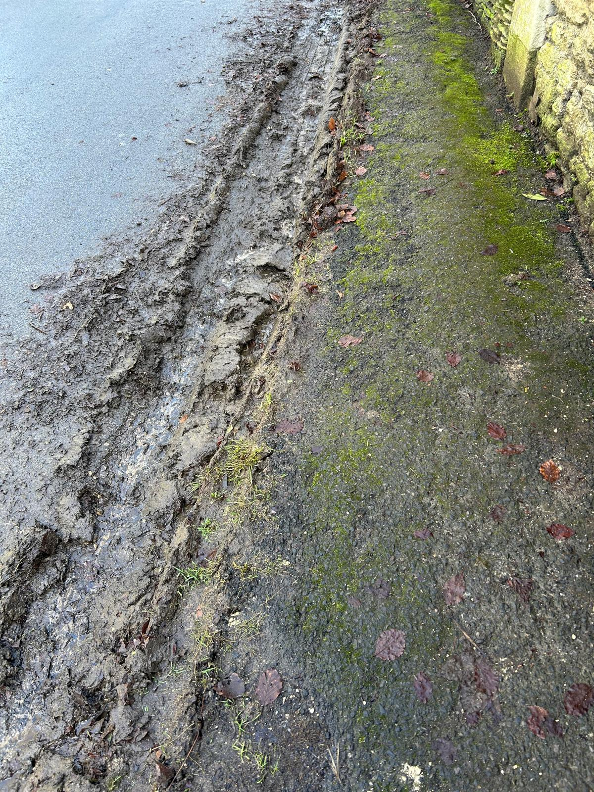
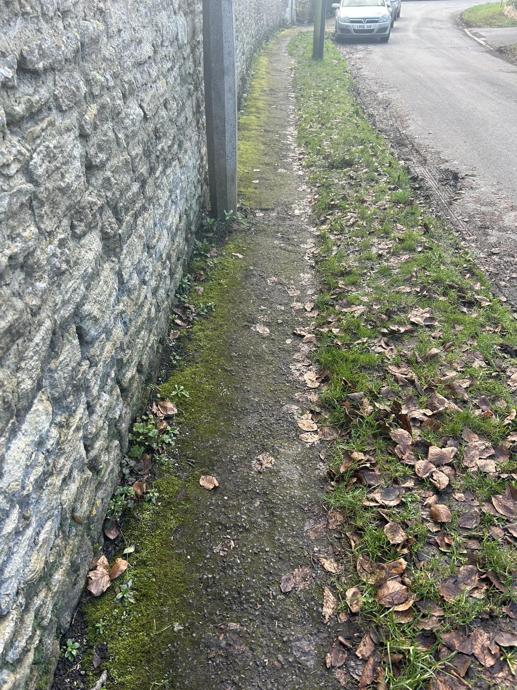
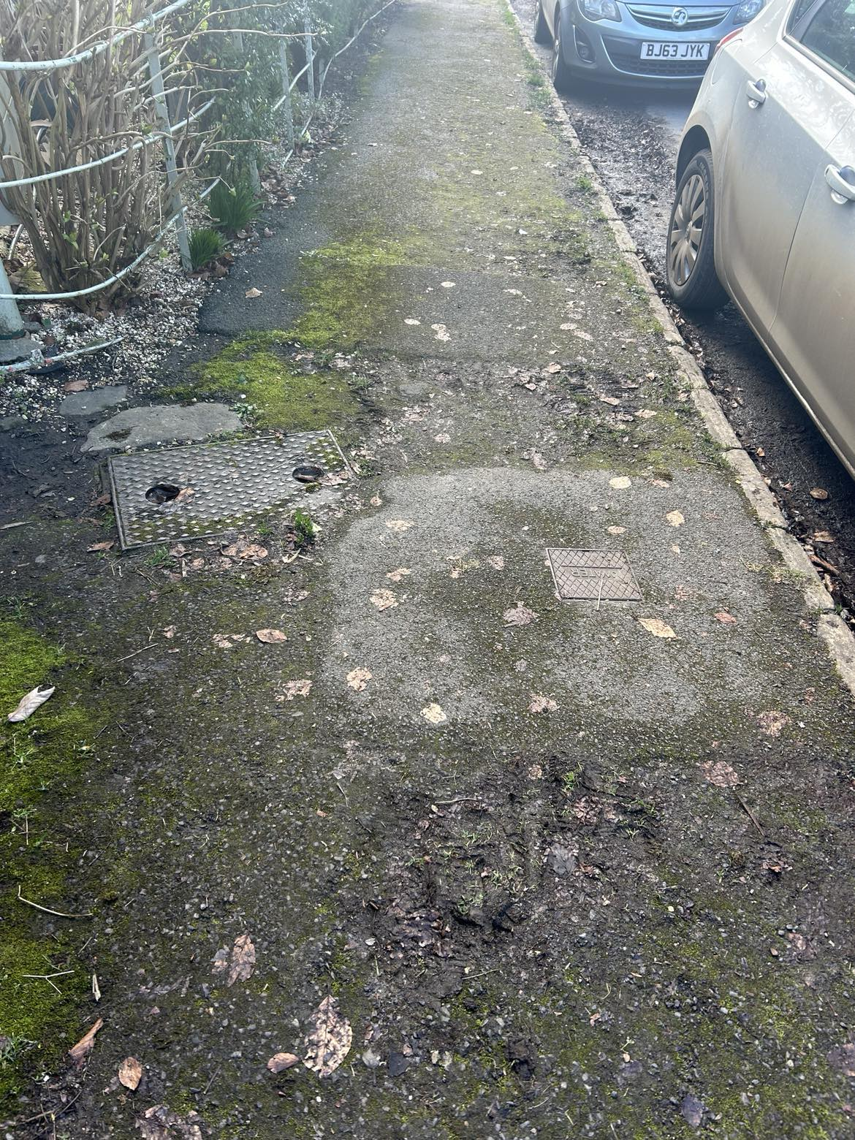
3. Bradley Lane
43. This footway has no clear beginning or end. Unsafe and unfit for purpose. Where it is wider it is holey, bumpy and uneven (pic 3) and unstable with no clear end before poor visibility to left.
00238680 This issue is under investigation. An improvement to the existing footpath should be put forward under the LHFIG scheme.

Slide 5
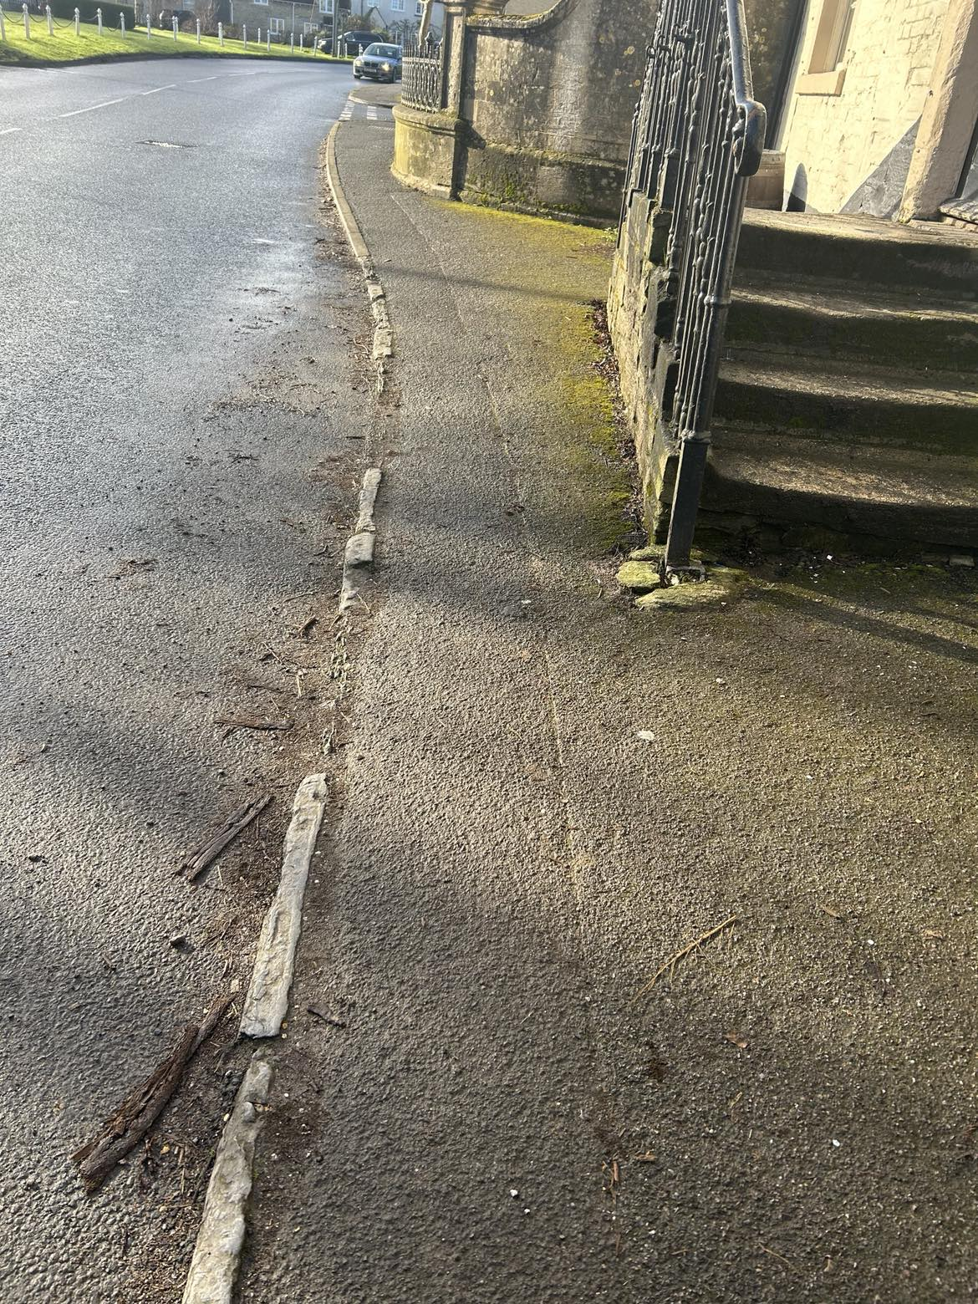
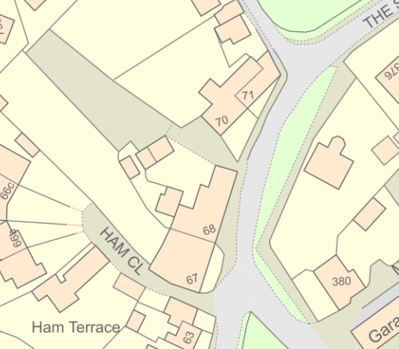
4. Ham Green to Ground Corner.
8. Kerbs failing/missing. Camber of footway and narrowing by pub steps, without proper edging feels like could easily step into road with cars whizzing past. Dropped kerb needed and on opposite side of road too to access footway to The Walk.
00238689 This issue has already been reported and is under investigation. Footpath surface has been checked and considered safe. Any improvements would need to be put forward under the LHFIG scheme.

Slide 6
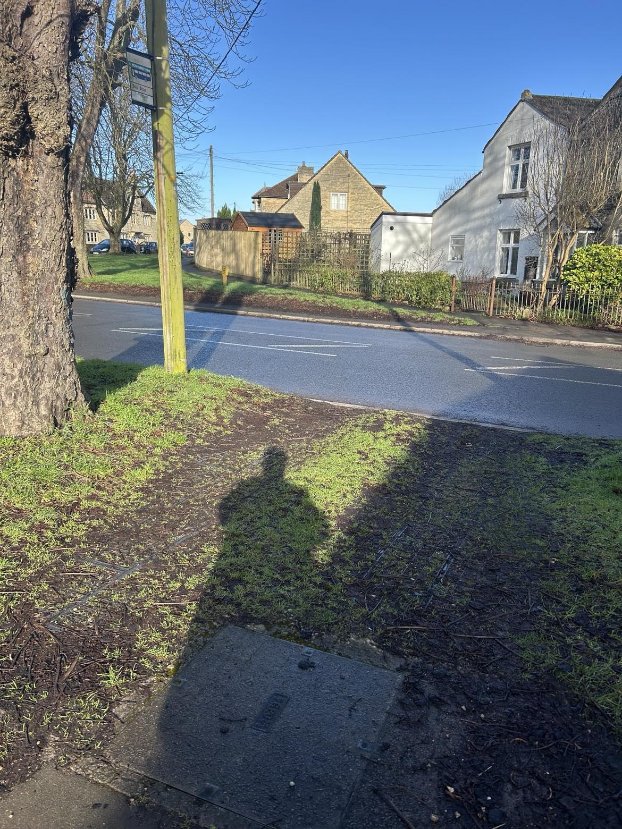
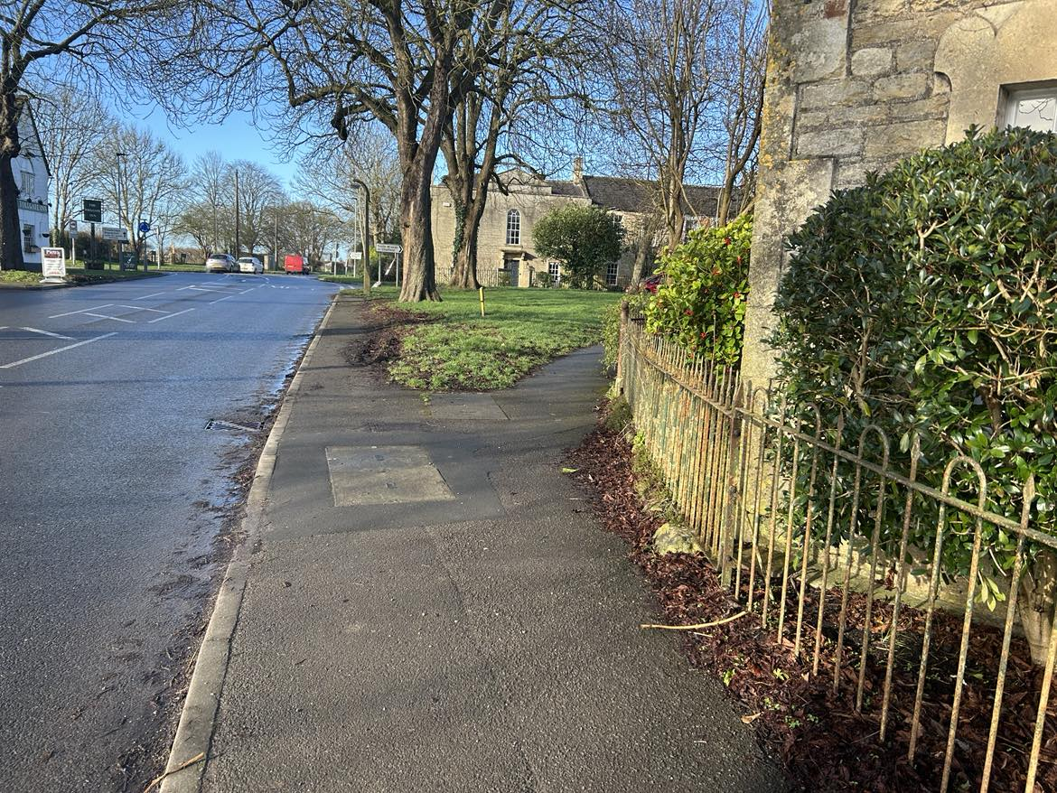
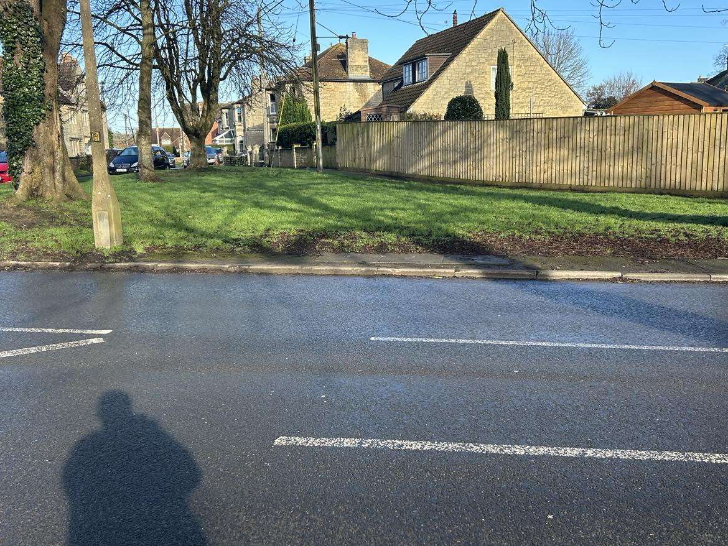
5. Leigh Road to Ham Green.
3. Dropped kerb is not defined outside 56 HG. Potential to create crossing with red tarmac, posts as per photo 10 to indicate crossing like for The Courts? It is opposite the bus stop too.
4. Footway just goes to lamppost – potential of dropped kerb/ramp to meet up with Pietra driveway? Red tarmac to indicate crossing?
6. Surface by bus stop? What is it?
Dropped kerb to 56 HG opposite. Make more of a crossing opportunity? Red tarmac.
00238688 Any improvement such as this should be put forward to the LHFIG scheme for consideration.

Slide 7
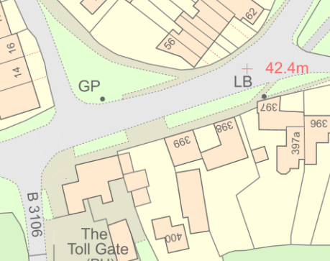
3
4
Define dropped kerbs to create crossing area.
6
NB.
It is a bus stop used by children as well as all residents.

Slide 8
LHFIG 5 requests - Dropped Kerb locations
Little Parks to continue on footway across the cul de sac.
Station Road to continue on Station Road
The Common up to The Gravel entrance
Station Road at Green Close junction to enable pedestrians to continue on Station Road
Green Close – bottom of Green Close to access footway to Avonfield

Slide 9
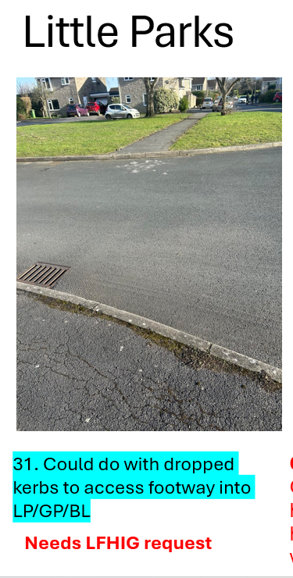
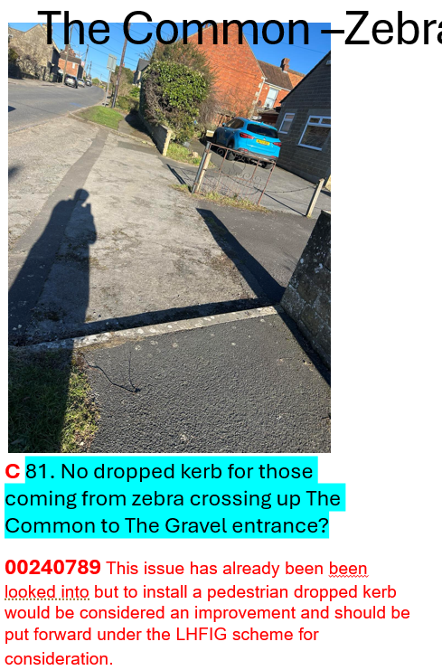
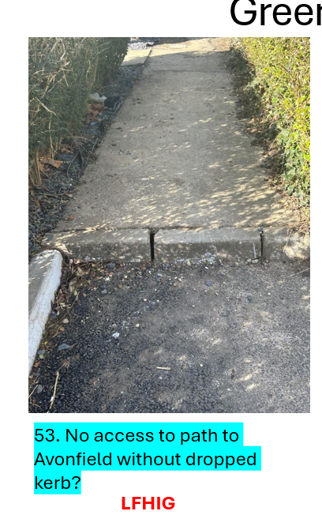
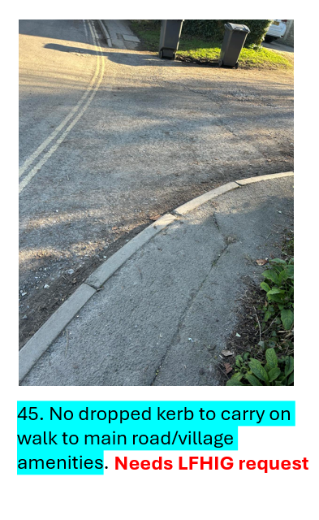
Dropped kerbs x4 locations and slide 7/8
1
2
3
5
Station Road

Slide 10
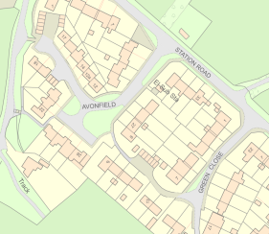
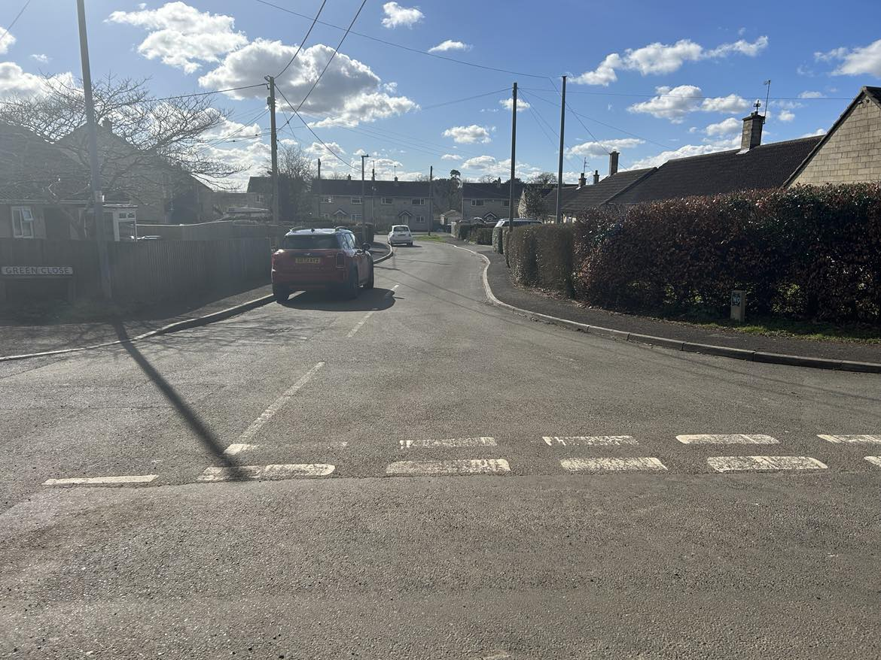
Green Close down to Avonfield path
4
5
Need photo
51
51. When walking down Station Road there is no dropped kerb at Green Close – have to walk into GC quite a way to get to a driveway to then cross the road to get to the footway to continue walking on Station Road.
LFHIG ​

