Slide 1
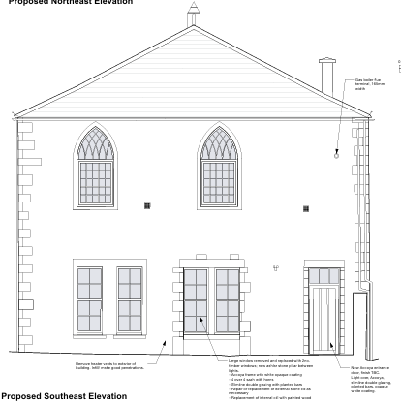
Site Address
UNITED REFORMED CHURCH, THE STREET, HOLT, BA14 6RS
https://development.wiltshire.gov.uk/pr/s/planning-application/a0iQ300000Ip4Yf/pl202600089
Proposal
External works to the church and hall comprising the installation of a photovoltaic array with associated battery storage, new access ramp and handrails to the main church entrance, reconfiguration of a ground floor window and entrance door to the south-east elevation of the hall, infilling of a redundant boiler room door, removal of redundant mechanical services and installation of new ductwork and terminals, together with the provision of Sheffield cycle stands, protective bollards and associated planting.
Officer Name
Andrew Thomas
Consultation Deadline
20/02/2026

Slide 2
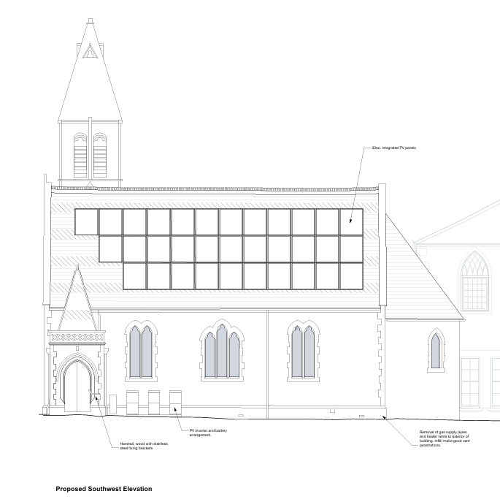
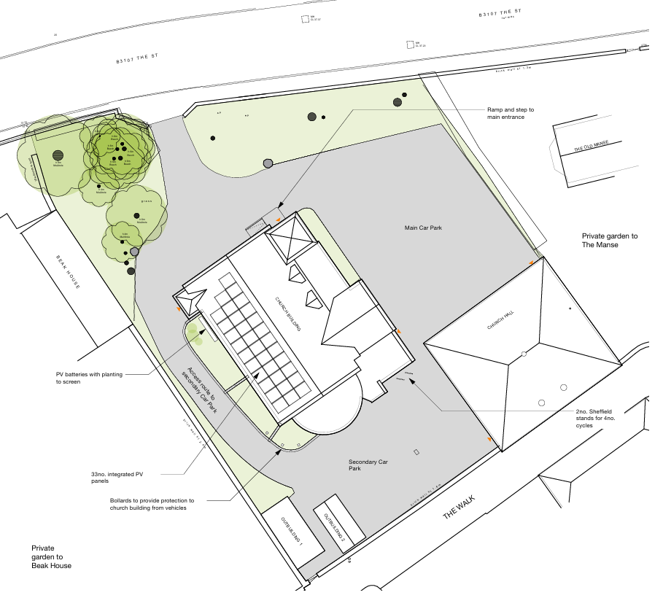

Slide 3
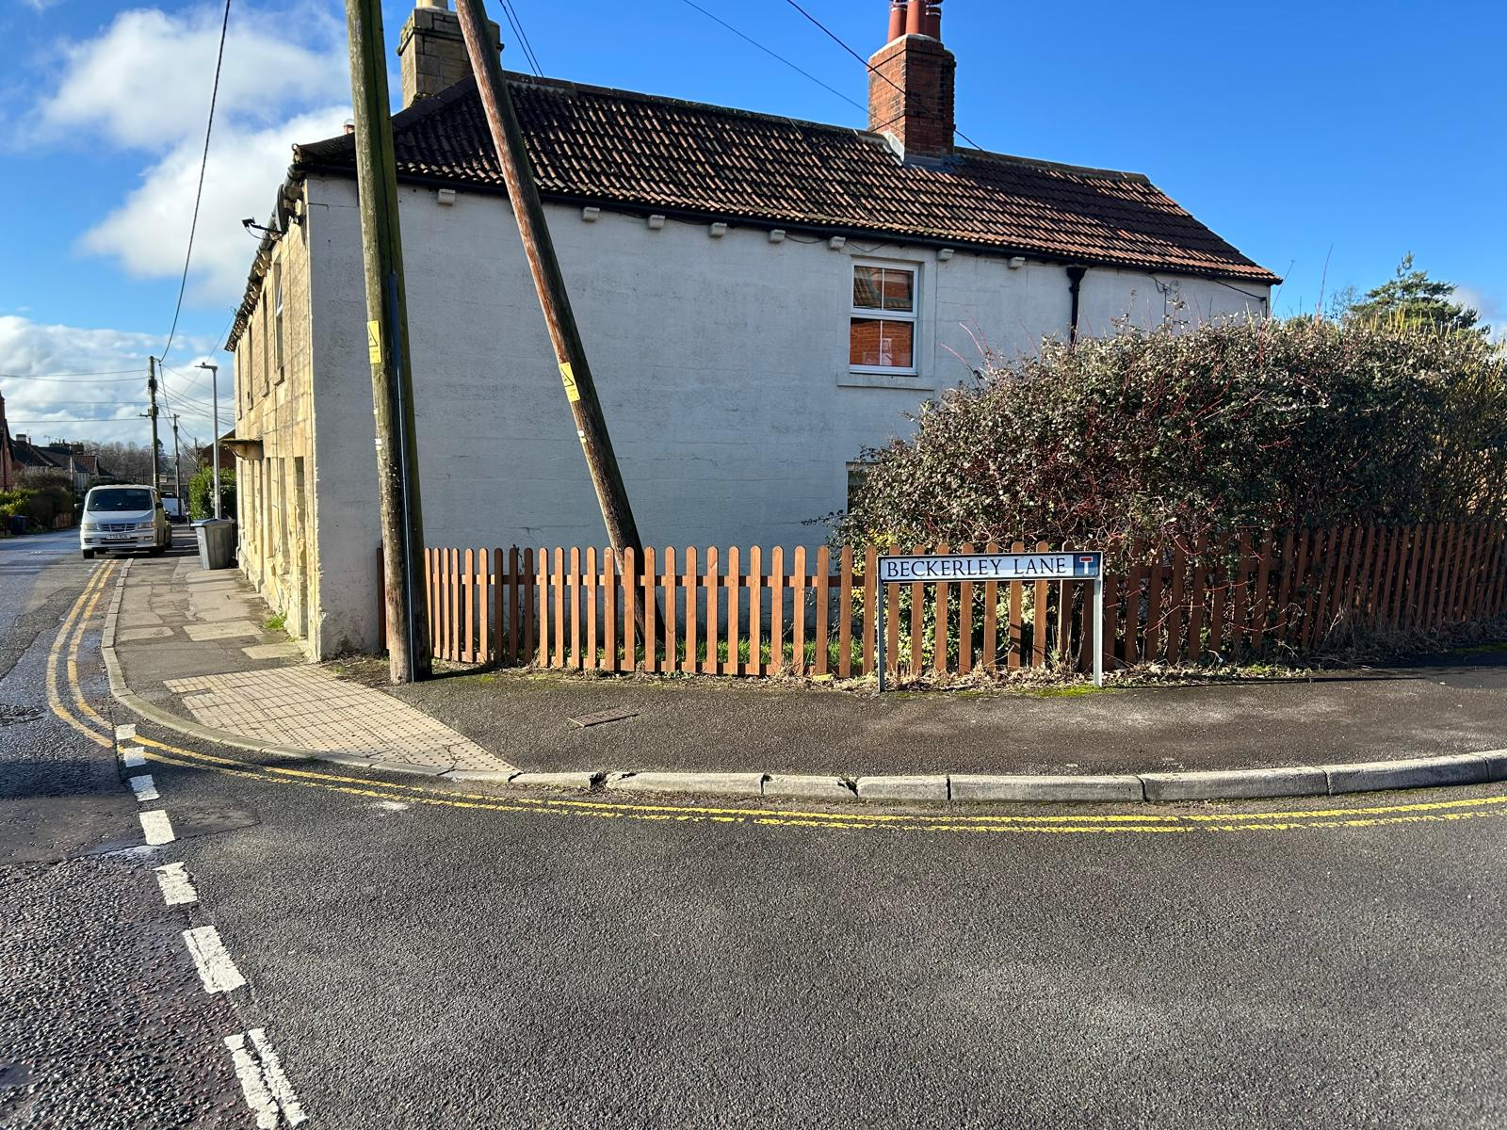
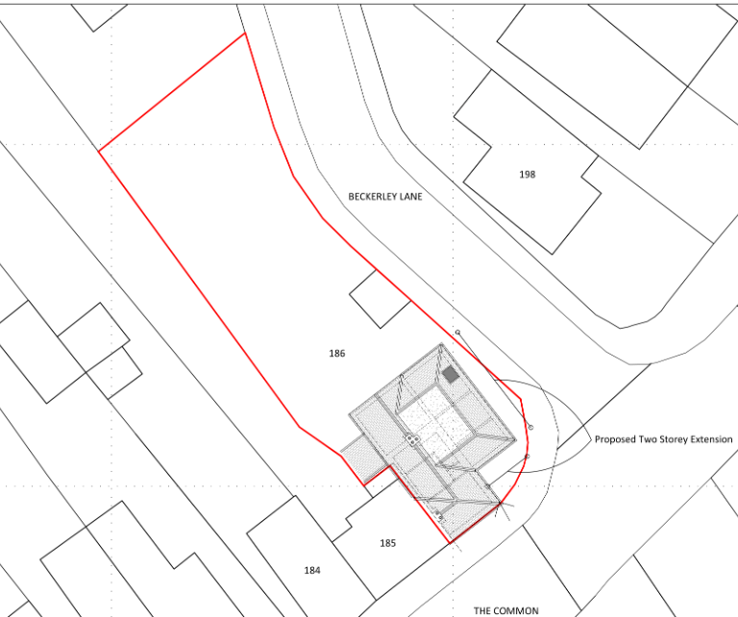
Site Address
186 The Common, Holt, Trowbridge, BA14 6QL
https://development.wiltshire.gov.uk/pr/s/planning-application/a0iQ300000J4gQjIAJ/pl202600376?tabset-8903c=2
Proposal
Proposed two storey side extension
Consultation Deadline
20/02/2026
Officer Name
Steven Vellance

Slide 4
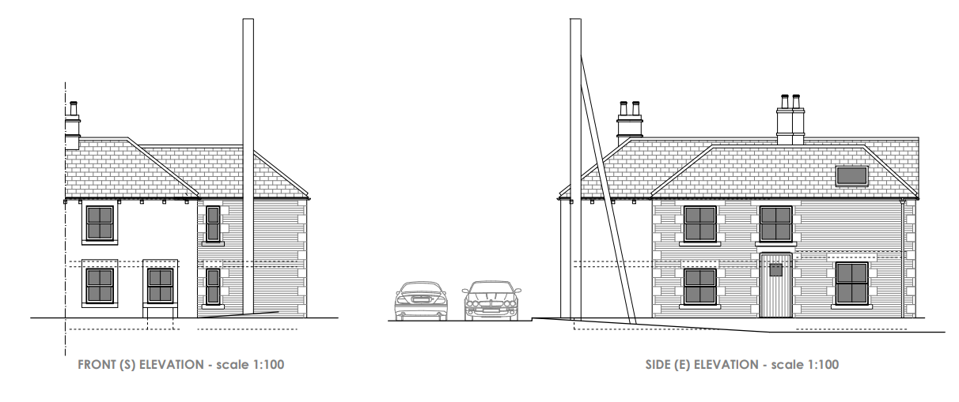
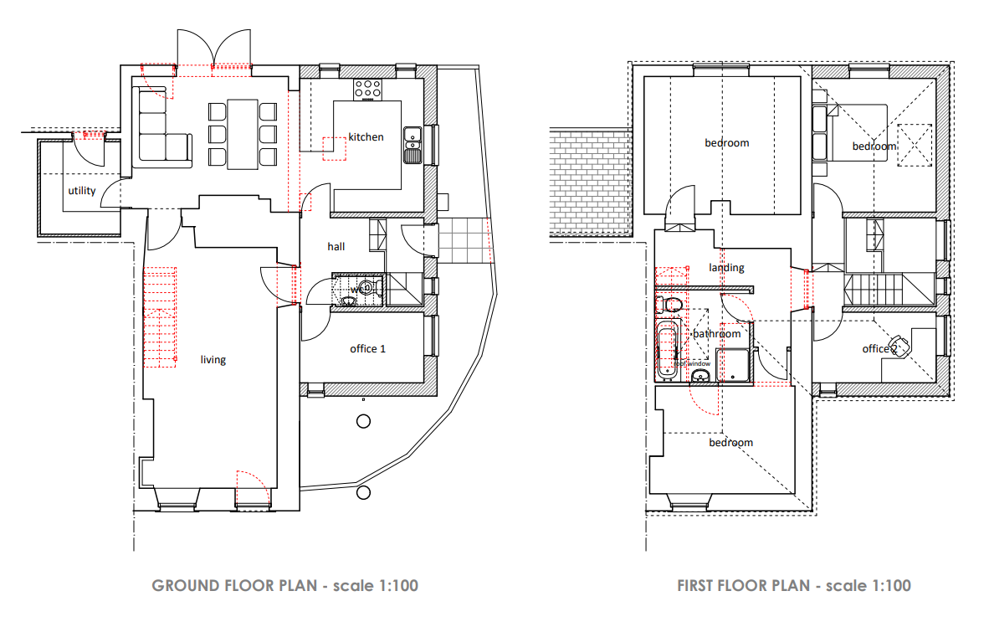
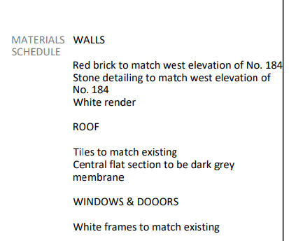

Slide 5
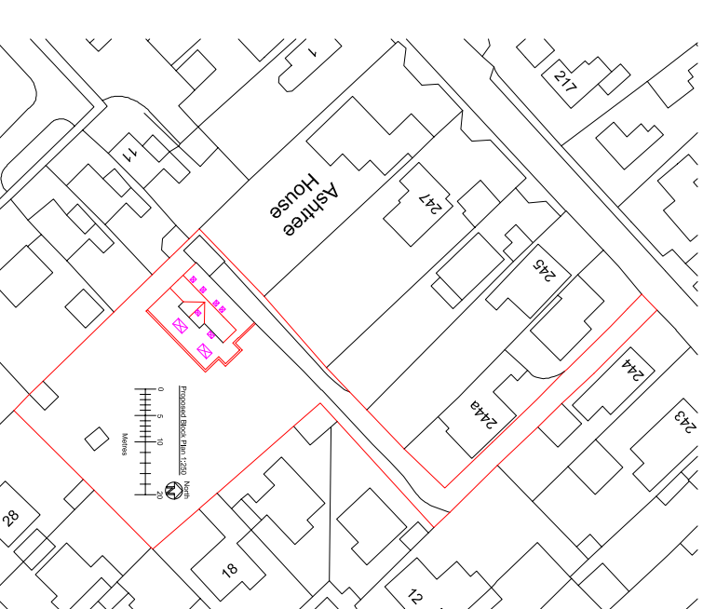
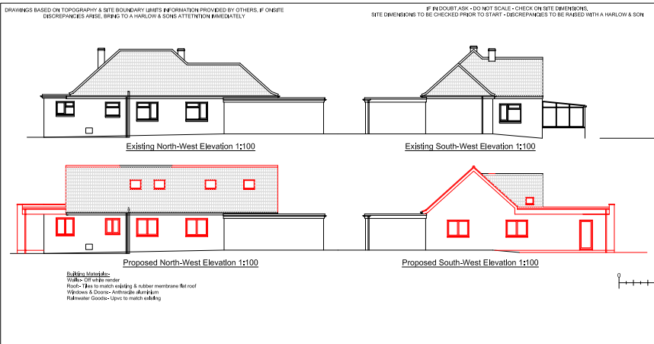

Site Address
243B Melksham Road, Holt, Trowbridge, BA14 6QW
https://development.wiltshire.gov.uk/pr/s/planning-application/a0iQ300000J7qzp/pl202600457?tabset-8903c=2
Proposal
Proposed Roof Alterations and Extensions
Consultation Deadline
25/02/2026
Officer Name
Selina (Nina) Parker-Miles

Slide 6
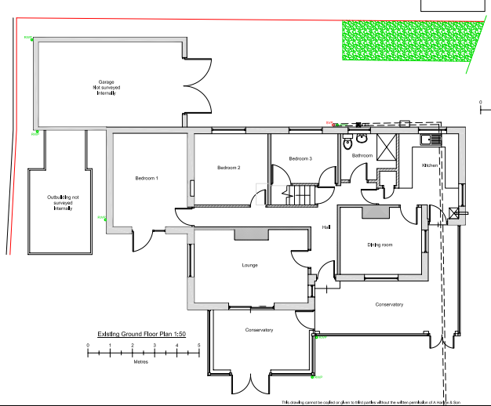
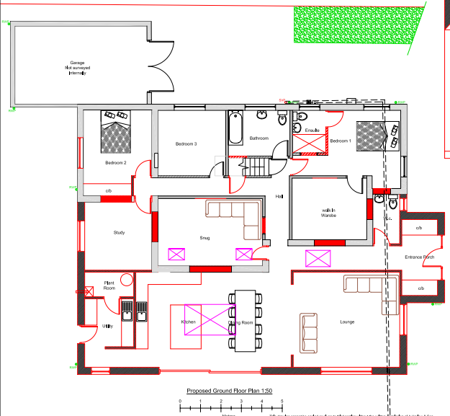
Existing
Proposed

Slide 7
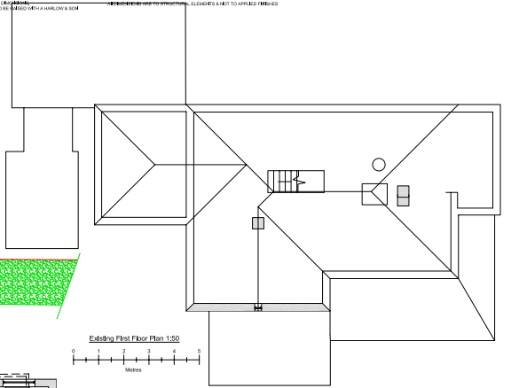
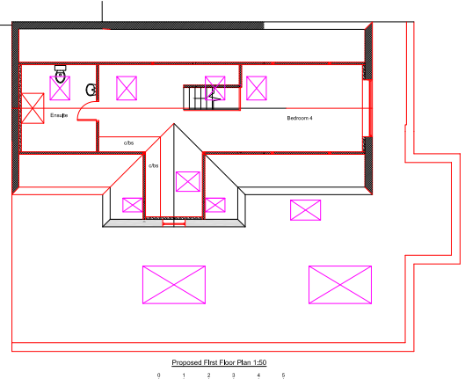
Existing
Proposed

Slide 8
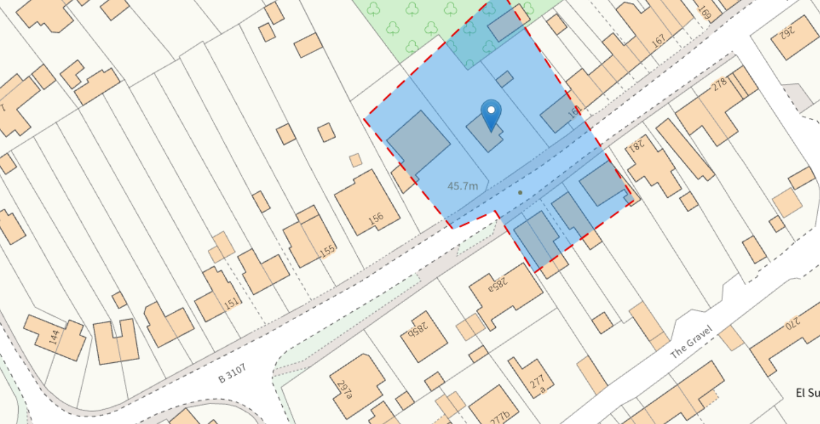
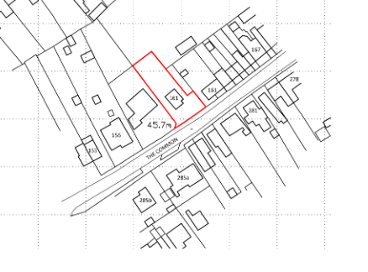
Site Address
159 The Common, Holt, Trowbridge, BA14 6QJ
https://development.wiltshire.gov.uk/pr/s/planning-application/a0iQ300000JBTADIA5/pl202600497
Proposal
Two storey side extension and single storey rear extension
Consultation Deadline
26/02/2026
Officer Name
Alex Edge

Slide 9
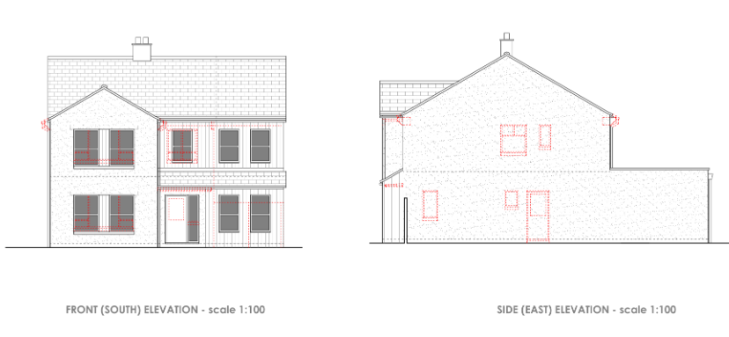
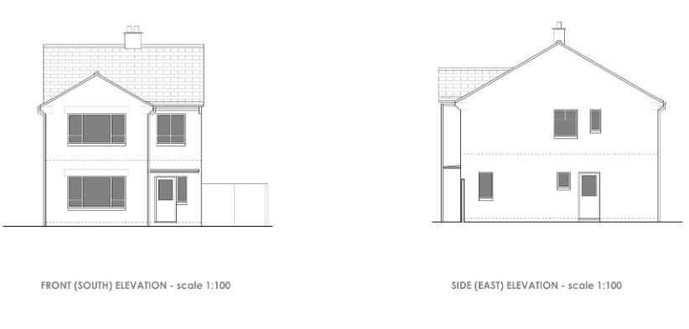
Existing
Proposed

Slide 10
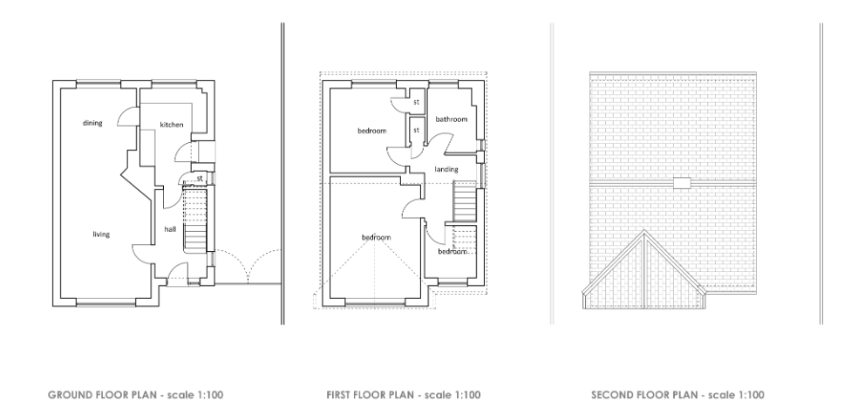
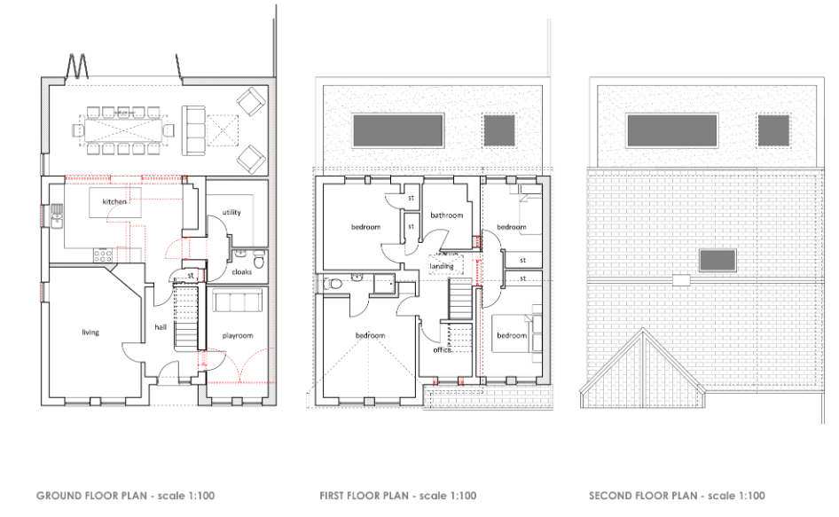
Proposed
Existing

Slide 11
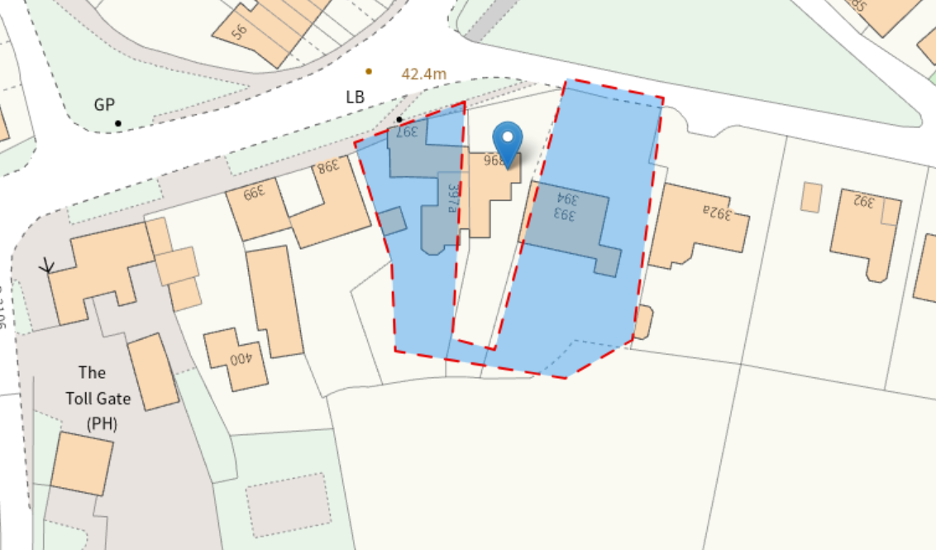
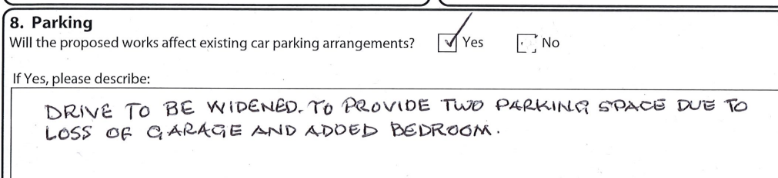
Site Address
396 Ham Green, Holt, Trowbridge, BA14 6PX
https://development.wiltshire.gov.uk/pr/s/planning-application/a0iQ300000JKWnB/pl202600702
Proposal
Two storey rear extension
Consultation Deadline
10/03/2026
Officer Name
Steven Vellance

Slide 12
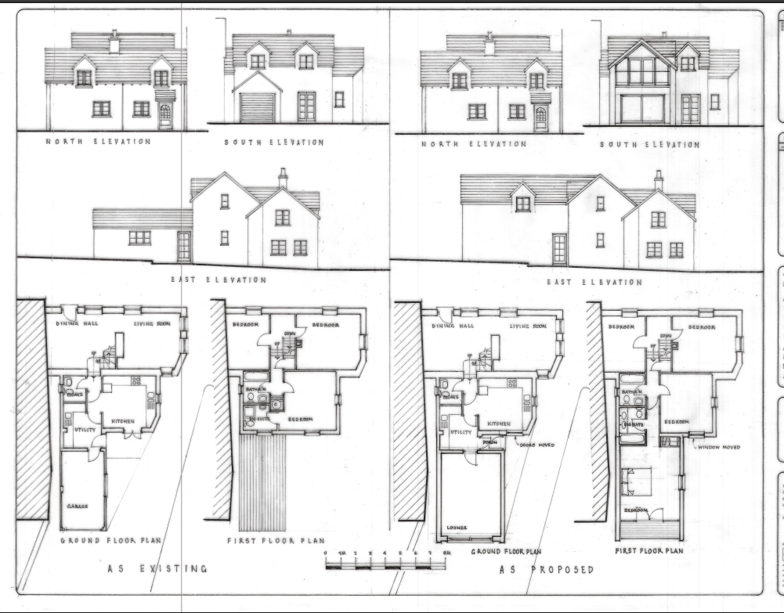

Slide 13
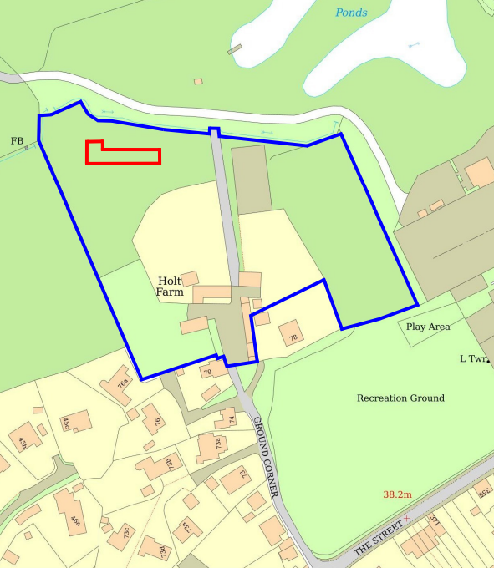
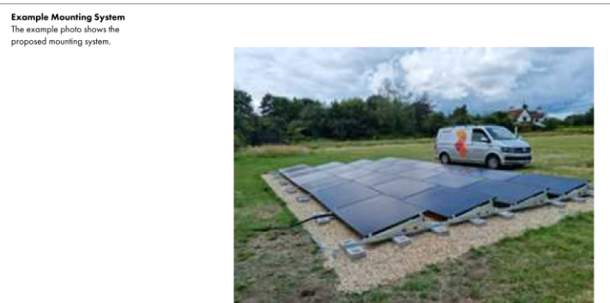
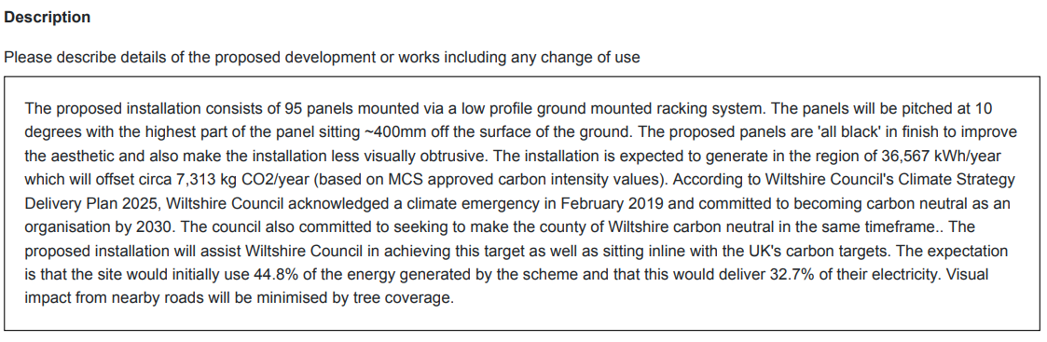
Site Address
Holt Farm, Ground Corner, Holt, Trowbridge, BA14 6RT
https://development.wiltshire.gov.uk/pr/s/planning-application/a0iQ300000JKX1h/pl202600705
Proposal
Proposed installation of 95 panels mounted via a low profile ground mounted racking system.
Consultation Deadline
11/03/2026
Officer Name
Andrew Thomas

Slide 14
